Slide 2


Inheritance
The objectives of this lecture are:
To explore the concept and implications of inheritance
  Polymorphism
To define the syntax of inheritance in Java
To understand the class hierarchy of Java
To examine the effect of inheritance on constructors

Slide 3
Terminology
Inheritance is a fundamental Object-Oriented concept
A class can be defined as a "subclass" of another class.
  The subclass inherits all data attributes of its superclass
  The subclass inherits all methods of its superclass
  The subclass inherits all associations of its superclass
The subclass can:
  Add new functionality
  Use inherited functionality
  Override inherited functionality
superclass:
Person
- name: String
- dob: Date
subclass:
Employee
- employeeID: int
- salary: int
- startDate: Date

Slide 4
How is this useful?
Economy of time – When you implement Employee, you already have all functionality of Person. No need to reimplement
Parameter passing – If you have a function that expects a Person, you can pass an Employee, and it is still fine.
  Fewer special-purpose functions for every type of Person that exists
Container classes (linked lists, binary trees, etc.) can be defined to hold a Person, and can hold any subclass of Person
  Allows limited heterogeneity in container classes
superclass:
Person
- name: String
- dob: Date
subclass:
Employee
- employeeID: int
- salary: int
- startDate: Date

Slide 5
What really happens?
When an object is created using new, the system must allocate enough memory to hold all its instance variables.
  This includes any inherited instance variables
In this example, we can say that an Employee "is a kind of" Person.
  An Employee object inherits all of the attributes, methods and associations of Person
Person
- name: String
- dob: Date
Person
name = "John Smith"
dob = Jan 13, 1954
Employee
name = "Sally Halls"
dob = Mar 15, 1968
employeeID = 37518
salary = 65000
startDate = Dec 15, 2000
is a kind of
Employee
- employeeID: int
- salary: int
- startDate: Date

Slide 6
Inheritance in Java
Inheritance is declared using the "extends" keyword
  If inheritance is not defined, the class extends a class called Object
public class Person
{
private String name;
private Date dob;
[...]
Person
- name: String
- dob: Date
public class Employee extends Person
{
private int employeID;
private int salary;
private Date startDate;
[...]
Employee
- employeeID: int
- salary: int
- startDate: Date
Employee anEmployee = new Employee();

Slide 7
Inheritance Hierarchy
Each Java class has one (and only one) superclass.
  C++ allows for multiple inheritance
Inheritance creates a class hierarchy
  Classes higher in the hierarchy are more general and more abstract
  Classes lower in the hierarchy are more specific and concrete
There is no limit to the number of subclasses a class can have
There is no limit to the depth of the class tree.
Class
Class
Class
Class
Class
Class
Class
Class

Slide 8
The class called Object
At the very top of the inheritance tree is a class called Object
All Java classes inherit from Object.
  All objects have a common ancestor
  This is different from C++
The Object class is defined in the java.lang package
  Examine it in the Java API Specification
Object

Slide 9
Constructors and Initialization
Classes use constructors to initialize instance variables
  When a subclass object is created, its constructor is called.
  It is the responsibility of the subclass constructor to invoke the appropriate superclass constructors so that the instance variables defined in the superclass are properly initialized
Superclass constructors can be called using the "super" keyword in a manner similar to "this"
  It must be the first line of code in the constructor
If a call to super is not made, the system will automatically attempt to invoke the no-argument (default) constructor of the superclass.

Slide 10
Constructors - Example
public class BankAccount
{
private String ownersName;
private int accountNumber;
private float balance;
public BankAccount(int anAccountNumber, String aName)
{
accountNumber = anAccountNumber;
ownersName = aName;
}
[...]
}
public class OverdraftAccount extends BankAccount
{
private float overdraftLimit;
public OverdraftAccount(int anAccountNumber, String aName, float aLimit)
{
super(anAccountNumber, aName);
overdraftLimit = aLimit;
}
}

Slide 11
Method Overriding
Subclasses inherit all methods from their superclass
  Sometimes, the implementation of the method in the superclass does not provide the functionality required by the subclass.
  In these cases, the method must be overridden.
To override a method, provide an implementation in the subclass.
  The method in the subclass MUST have the exact same signature as the method it is overriding.

Slide 12
Method overriding - Example
public class BankAccount
{
private String ownersName;
private int accountNumber;
protected float balance;
public void deposit(float anAmount)
{
if (anAmount>0.0)
balance = balance + anAmount;
}
public void withdraw(float anAmount)
{
if ((anAmount>0.0) && (balance>anAmount))
balance = balance - anAmount;
}
public float getBalance()
{
return balance;
}
}

Slide 13
Method overriding - Example
public class OverdraftAccount extends BankAccount
{
private float limit;
@Override // This provides a compiler check of signature
public void withdraw(float anAmount)
{
if ((anAmount>0.0) && (getBalance()+limit>anAmount))
balance = balance - anAmount;
}
}

Slide 14
Object References and Inheritance
Inheritance defines "a kind of" relationship.
  In the previous example, OverdraftAccount "is a kind of" BankAccount
Because of this relationship, programmers can "substitute" object references.
  A superclass reference can refer to an instance of the superclass OR an instance of ANY class which inherits from the superclass.
BankAccount anAccount = new BankAccount(123456, "Craig");
BankAccount account1 = new OverdraftAccount(3323, "John", 1000.0);
BankAccount
name = "Craig"
accountNumber = 123456
anAccount
OverdraftAccount
name = "John"
accountNumber = 3323
limit = 1000.0
account1

Slide 15
Polymorphism
In the previous slide, the two variables are defined to have the same type at compile time: BankAccount
  However, the types of objects they are referring to at runtime are different
What happens when the withdraw method is invoked on each object?
  anAccount refers to an instance of BankAccount. Therefore, the withdraw method defined in BankAccount is invoked.
  account1 refers to an instance of OverdraftAccount. Therefore, the withdraw method defined in OverdraftAccount is invoked.
Polymorphism is: The method being invoked on an object is determined AT RUNTIME and is based on the type of the object receiving the message.

Slide 16
Final Methods and Final Classes
Methods can be qualified with the final modifier
  Final methods cannot be overridden.
  This can be useful for security purposes.
public final boolean validatePassword(String username, String Password)
{
[...]
Classes can be qualified with the final modifier
  The class cannot be extended
  This can be used to improve performance. Because there an be no subclasses, there will be no polymorphic overhead at runtime.
public final class Color
{
[...]

Slide 17
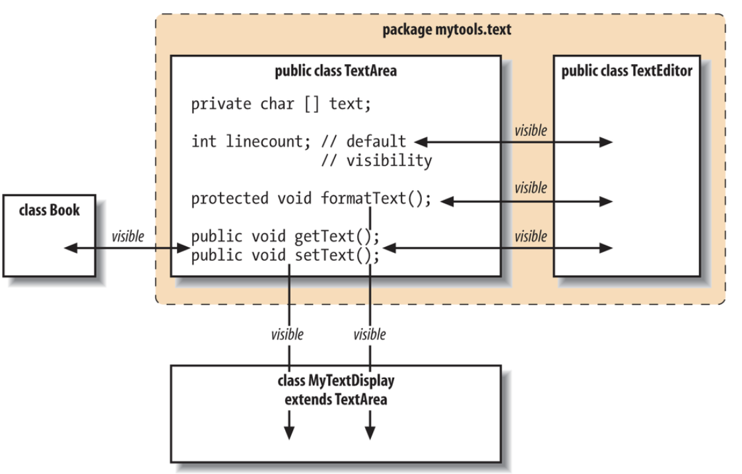
Permissions
Modifier | Visibility outside class
private | None
no modifier | Classes in the package
protected | Classes in package & all subclasses
public | All classes

Slide 18
Review
What is inheritance? What is a superclass? What is a subclass?
Which class is at the top of the class hierarchy in Java?
What are the constructor issues surrounding inheritance?
What is method overriding? What is polymorphism? How are they related?
What is a final method? What is a final class?

